Slide 1
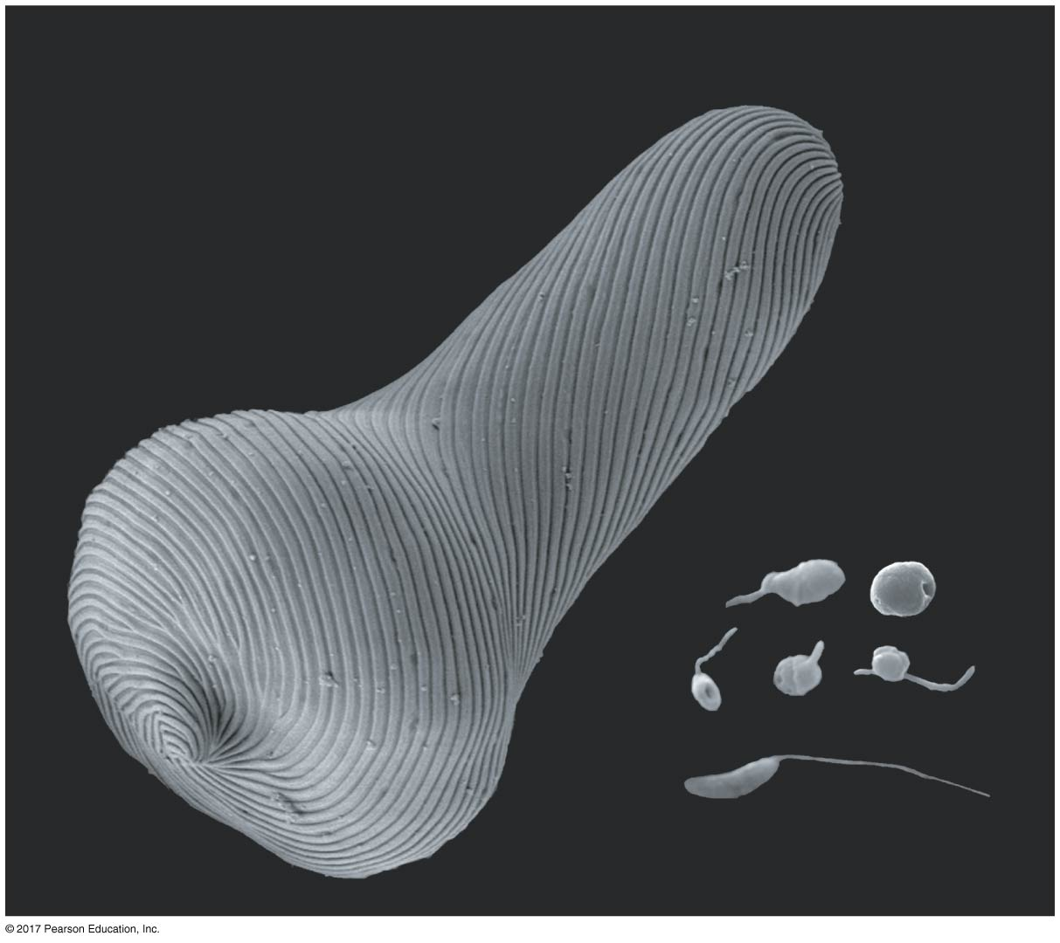
CH 28
BIOL 1202
General Biology II Lecture
CHAPTER 28
Protists
Dr. Adam Hrincevich
Notes:
Figure 28.1 Which of these organisms are prokaryotes and which are eukaryotes?

Slide 2
CH 28 Learning Objectives
Describe the process of secondary endosymbiosis and explain its role in eukaryotic history.
Characterize the excavates.
Give examples of the protists classified in SAR.
Describe characteristics of red and green algae.
Identify and describe the closest eukaryotic relatives of fungi and animals.
Give examples of ecological roles played by protists.
I would suggest completing the crossword puzzle to help you understand the terminology and correlate how the terms relate to topics covered in this chapter.

Slide 3
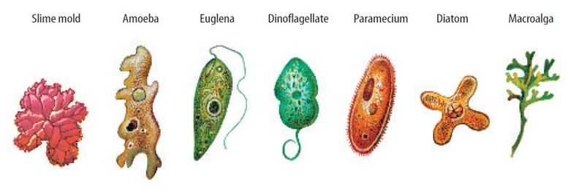
Concept 28.1: Most eukaryotes are single-celled organisms
Protists are
Eukaryotic cells have organelles and are more complex than
Important characters include
  the organisms
  most protists

Slide 4
Structural and Functional Diversity in Protists
Protists exhibit more structural and functional diversity than
Though most protists are unicellular, there are some colonial and
Protists can be
Protists, the most nutritionally diverse of all eukaryotes, include
  Photoautotrophs:
  Heterotrophs:
  Mixotrophs:
They use both sexual and asexual

Slide 5
Four Supergroups of Eukaryotes
Our understanding of the evolutionary relationships among protist groups
Several hypotheses have been
One current hypothesis divides all eukaryotes (including protists) into

Slide 6
Endosymbiosis in Eukaryotic Evolution
There is now considerable evidence that much protist diversity has
Endosymbiosis is a relationship between two species in which one organism lives inside the cell or cells of
Mitochondria and plastids are derived from prokaryotes that were engulfed by the ancestors of early eukaryotic cells, possibly
Mitochondria evolved once by endosymbiosis of an alpha
Plastids evolved later by

Slide 7
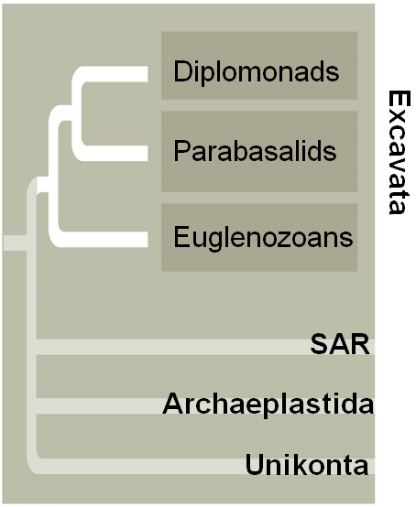
Concept 28.2: Excavates include protists with modified mitochondria and protists with unique flagella
The clade Excavata is characterized by its
Some members have an “excavated” feeding groove on
The excavates include three monophyletic groups: the
Notes:
Figure 28.UN02 In-text figure, Excavata, p. 597

Slide 8
EXCAVATA: Diplomonads and Parabasalids
These two groups lack plastids and have modified mitochondria, most
Diplomonads
  have reduced
  derive energy from
  have two
  are often parasites, EX: Giardia intestinalis
Parabasalids
  have reduced mitochondria called hydrogenosomes that
  include Trichomonas vaginalis, a
Notes:
Giardia intestinalis is also know as “Beaver Fever”

Slide 9
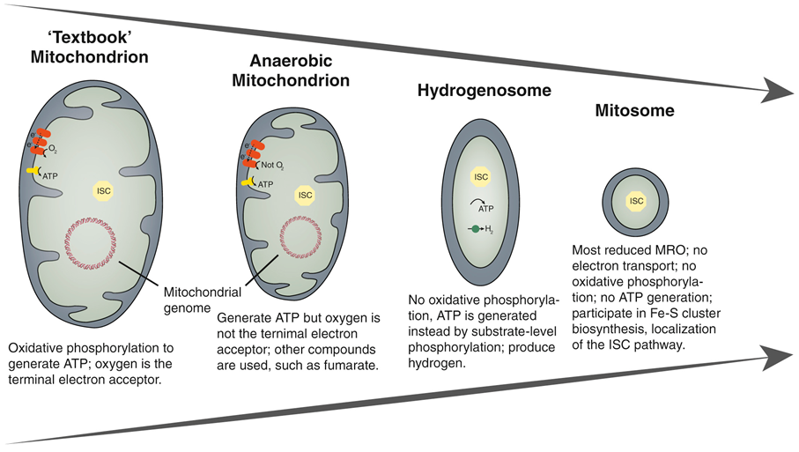
9
Mitochondrion vs. Hydrogenosome vs. Mitosome

Slide 10
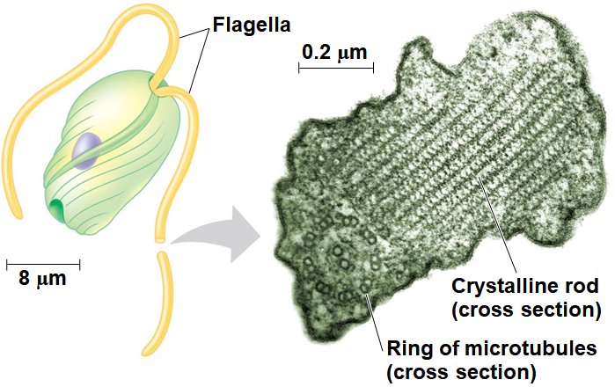
EXCAVATA: Euglenozoans
Euglenozoa is a diverse clade that includes predatory heterotrophs,
The main feature distinguishing them as a clade is a spiral or
This clade includes
Notes:
Figure 28.6 Euglenozoan flagellum

Slide 11
Kinetoplastids
Kinetoplastids have a single mitochondrion with an organized
Free-living species are consumers of prokaryotes in freshwater,
Some species parasitize animals, plants, and other protists
  EX: Kinetoplastids in the genus Trypanosoma cause African sleeping sickness in
  EX: Another pathogenic trypanosome causes Chagas’ disease (“
Trypanosomes evade host immune responses by producing cell-surface proteins with

Slide 12
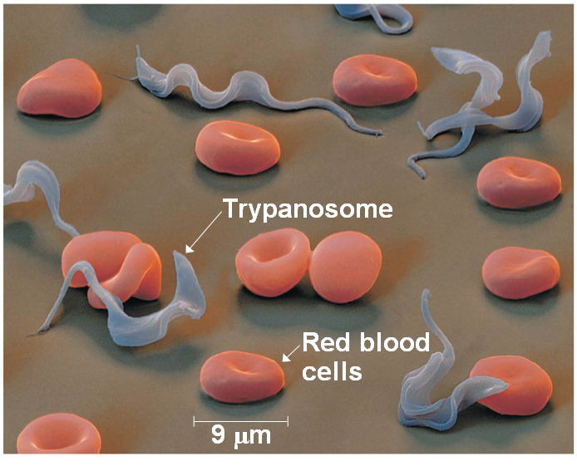
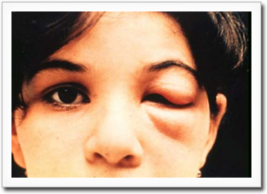
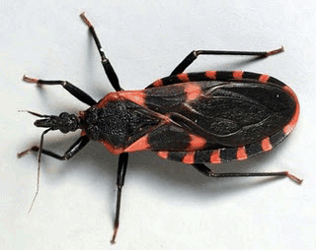
Figure 28.7
Sleeping Sickness
Kissing Bug bite causes Chagas’ Disease
Notes:
Figure 28.7 Trypanosoma, the kinetoplastid that causes sleeping sickness

Slide 13
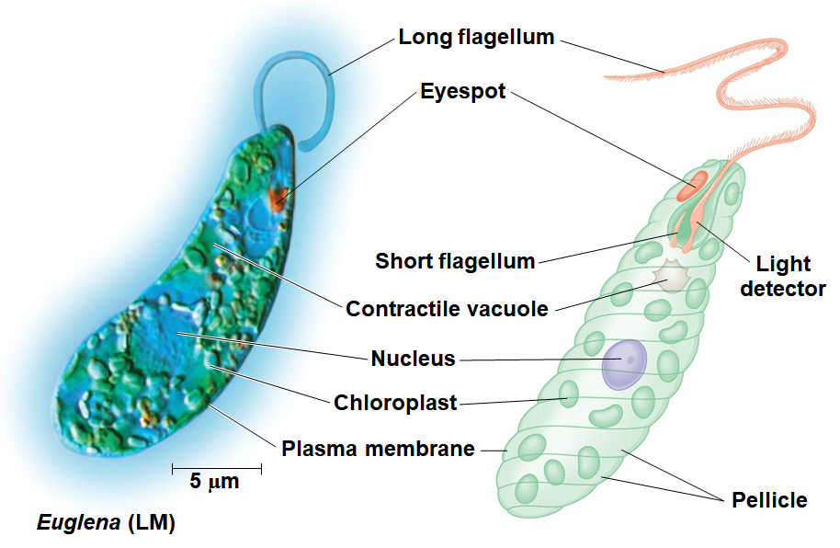
Euglenids
Euglenids have one or two flagella that emerge from a
Some species are mixotrophs; they can be autotrophic or
Notes:
Figure 28.8 Euglena, a euglenid commonly found in pond water

Slide 14
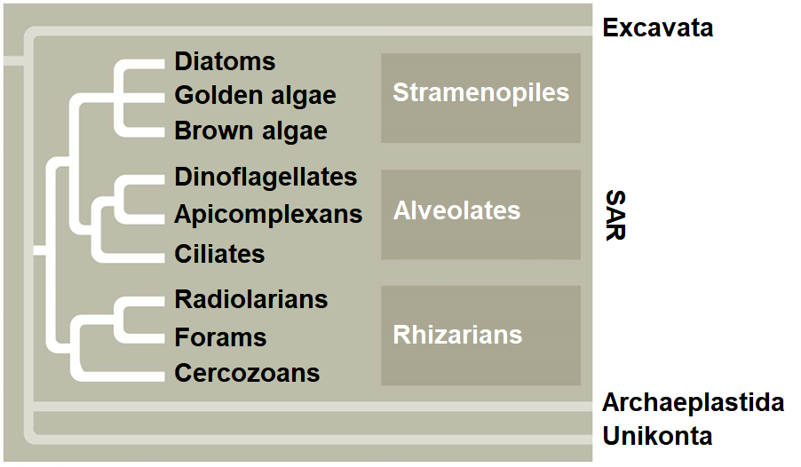
Concept 28.3: SAR is a highly diverse group of protists defined by DNA similarities
SAR is a monophyletic supergroup named for the first letters of its three major clades:
This group is one of the most
SAR
Notes:
Figure 28.UN03 In-text figure, the SAR clade, p. 599

Slide 15
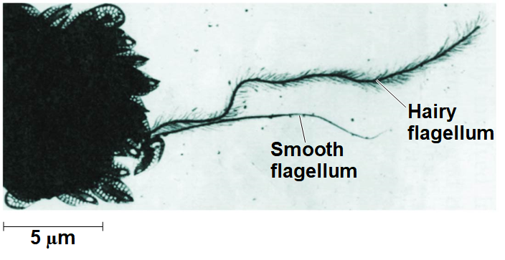
Stramenopiles
Stramenopiles includes some of the most important
Most have a “hairy” flagellum paired with a
Stramenopiles include
Notes:
Figure 28.9 Stramenopile flagella

Slide 16
Stramenopiles: Diatoms
Diatoms are unicellular algae with a unique two-part, glass-like
Diatoms are a major component of phytoplankton and are
After a diatom bloom, many dead individuals fall to the
The carbon they took up from the atmosphere and incorporated into their biomass is sequestered on the
Some scientists advocate fertilizing the ocean with iron to promote diatom

Slide 17
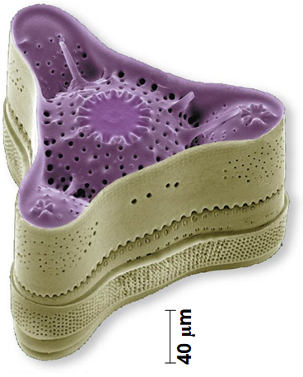
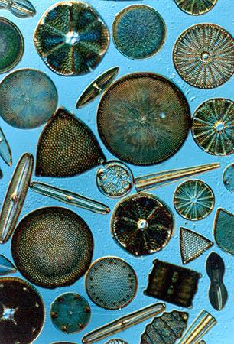
17
Various Diatom species
Notes:
Figure 28.10 The diatom Triceratium morlandii (colorized SEM)

Slide 18
Stramenopiles: Brown Algae
Brown algae are the
All are
Brown algae include many species commonly called “
Brown algal seaweeds have plantlike structures: the rootlike holdfast, which anchors the alga, and a stem-like stipe, which
Some have gas-filled, bubble-shaped floats to keep their
However, unlike plants, brown algae lack true

Slide 19
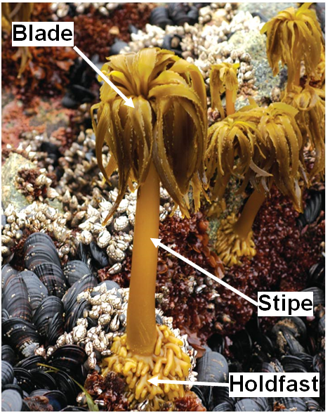
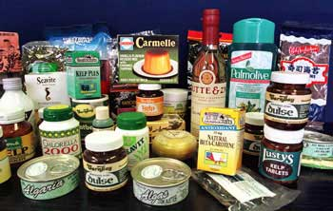
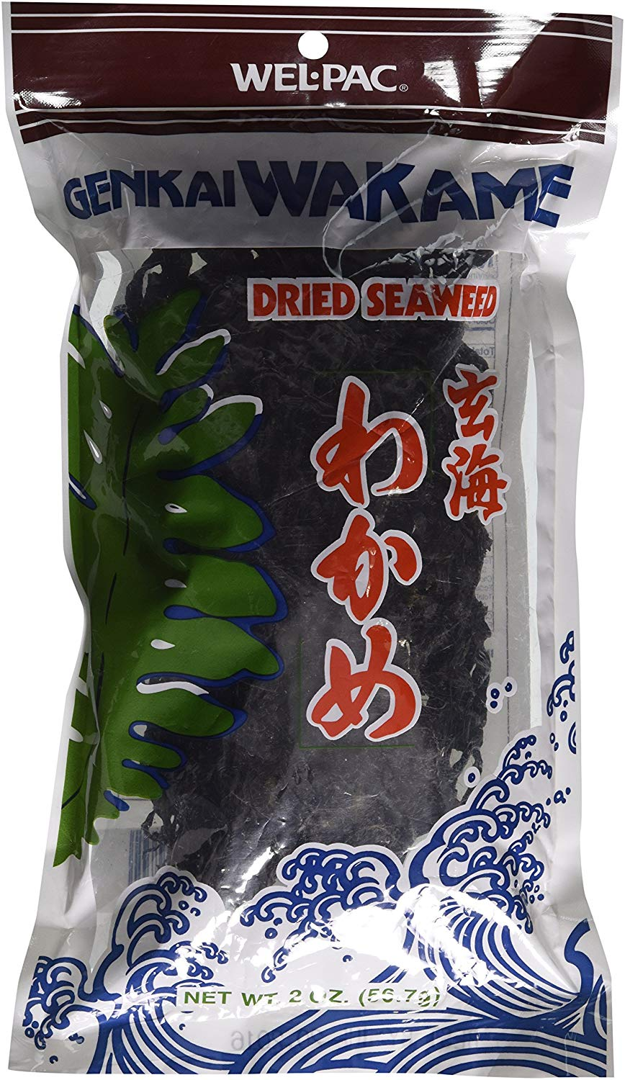
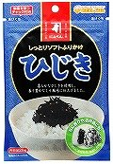
Figure 28.12
Commercial brown algae products
Notes:
Figure 28.12 Seaweeds: adapted to life at the ocean’s margins

Slide 20
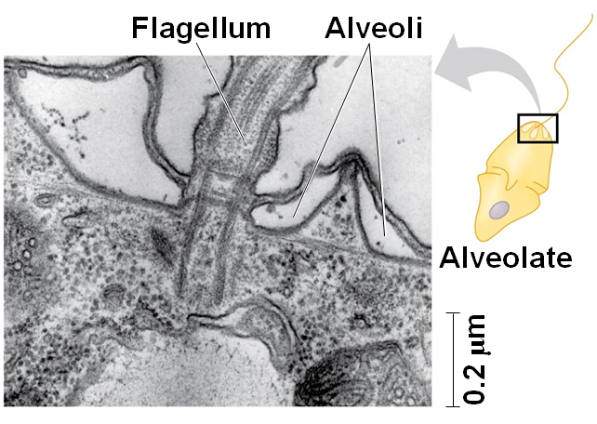
Alveolates
Alveolates have membrane-enclosed sacs (alveoli) just
The alveolates include
Notes:
Figure 28.14 Alveoli

Slide 21
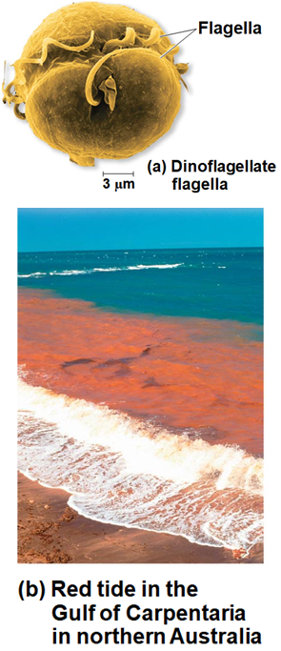
Alveolates: Dinoflagellates
Dinoflagellates have two flagella, and each cell is
They are abundant components of both marine and
They are a diverse group of aquatic phototrophs,
Toxic “red tides” are caused by
Notes:
Figure 28.15 Dinoflagellates

Slide 22
Alveolates: Apicomplexans
Most apicomplexans are parasites of animals; some cause
They spread through their host as infectious cells called
The life cycles of most species have sexual and asexual stages and
Plasmodium is the parasite that causes malaria
  Plasmodium requires both
  ~200 million infected yearly and
The first malarial vaccine, Mosquirix, was approved in Europe in 2015, but it

Slide 23
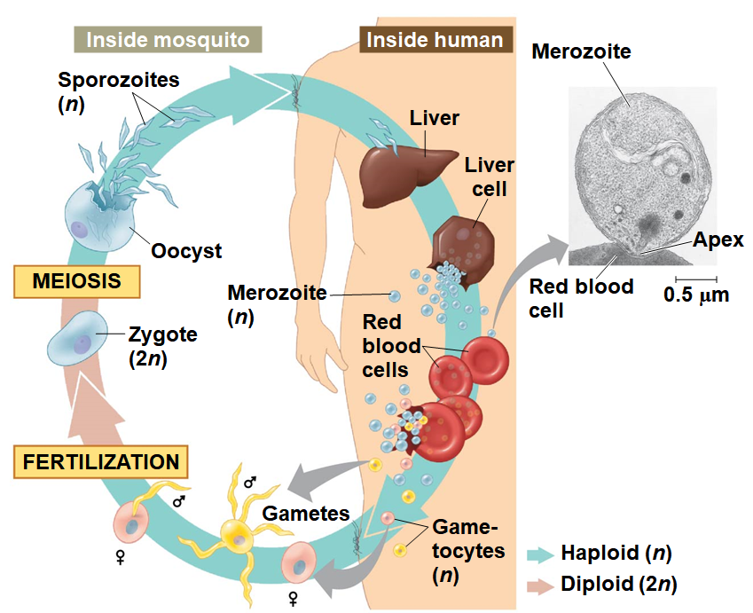
Notes:
Figure 28.16_3 The two-host life cycle of Plasmodium, the apicomplexan that causes malaria (step 3)

Slide 24
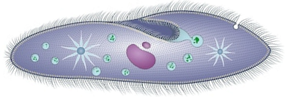
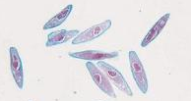
Alveolates: Ciliates
Ciliates, a large varied group of protists, are named for their use
Most ciliates are
A distinctive feature is
Genetic variation results from conjugation, in which two
Conjugation is a sexual process and is separate from reproduction, which
EX:

Slide 25
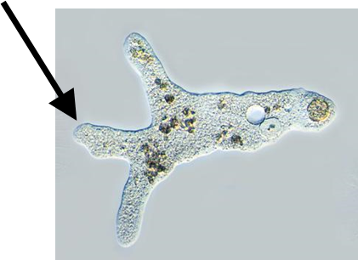
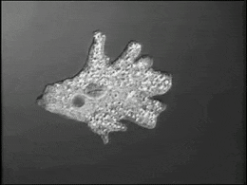
Rhizarians
Many species of rhizarians are
Amoebas are protists that move & feed by structures called
Rhizarian amoebas differ from amoebas in other clades by
Rhizarians include

Slide 26
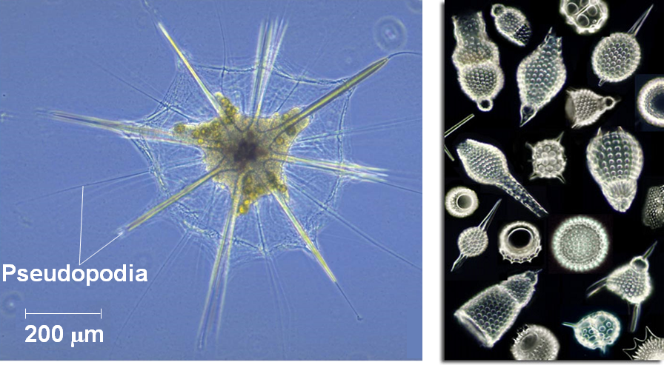
Rhizarians: Radiolarians
Radiolarians, mostly marine protists, have delicate, symmetrical
Pseudopodia reinforced by microtubules radiate from the
Cytoplasm covering the microtubules engulf prey that become
Notes:
Figure 28.18 A radiolarian

Slide 27
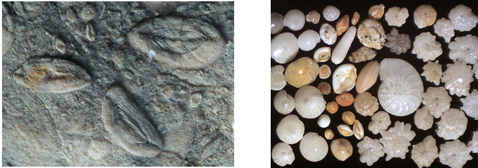
Rhizarians: Foraminiferans (or Forams)
Named for their porous shells, called “tests”, made of
Pseudopodia extend
Some house
Both
Magnesium content in fossilized forams can be used to
Notes:
Figure 28.19 Fossil forams

Slide 28
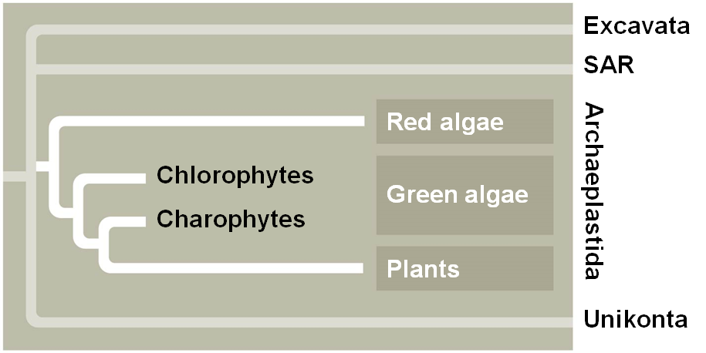
Concept 28.4: Red algae and green algae are the closest relatives of plants
Archaeplastida is the supergroup that includes
Notes:
Figure 28.UN04 In-text figure, Archaeplastida, p. 606

Slide 29
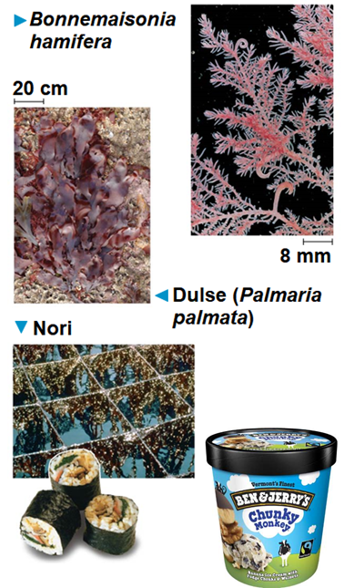
Red Algae
Red algae are reddish in color due to an accessory pigment called
The color varies from greenish-red in shallow water to dark red or
Red algae are usually multicellular; the
Red algae are the most abundant
Notes:
Figure 28.21 Red algae

Slide 30
Green Algae
Green algae are named for
Plants and green algae are
Green algae are
The two main groups are the
Charophytes are most
Most chlorophytes live in
Other chlorophytes live in damp soil, as symbionts in lichens, or in environments

Slide 31
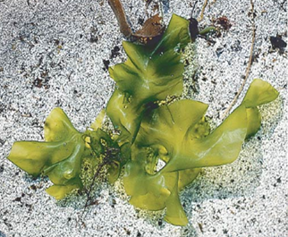
31
Larger size and greater complexity evolved in green algae by
  formation of
  formation of
  repeated division of nuclei with
Most chlorophytes have complex life cycles with both
Alternation of generations has evolved
(b) Ulva, or sea
lettuce
Notes:
Figure 28.22 Examples of large chlorophytes

Slide 32
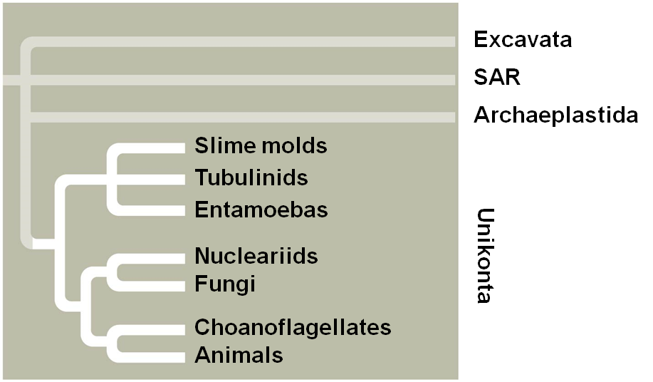
Concept 28.5: Unikonts include protists that are closely related to fungi and animals
The supergroup Unikonta includes
This group includes two clades:
It is unclear whether unikonts separated from
Notes:
Figure 28.UN05 In-text figure, Unikonta, p. 608

Slide 33
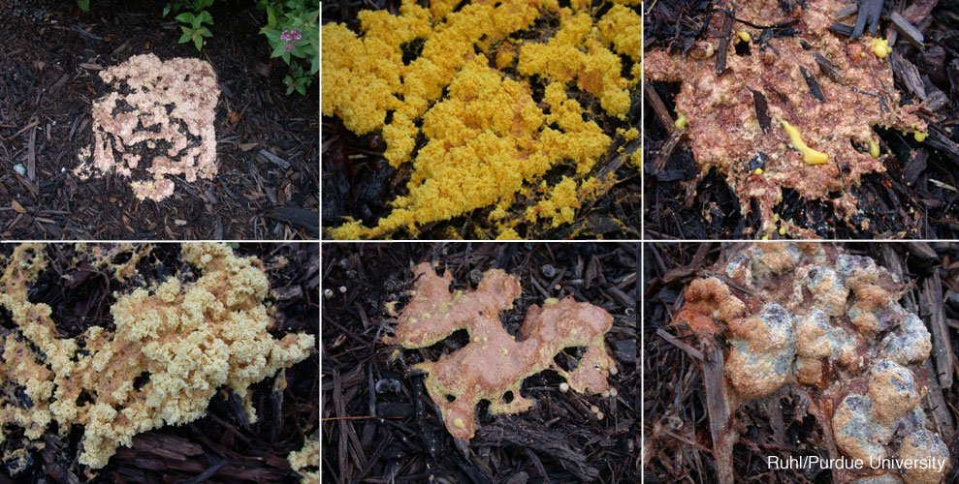
Amoebozoans
Amoebozoans are amoebas that have lobe- or tube-shaped, rather than
They include

Slide 34
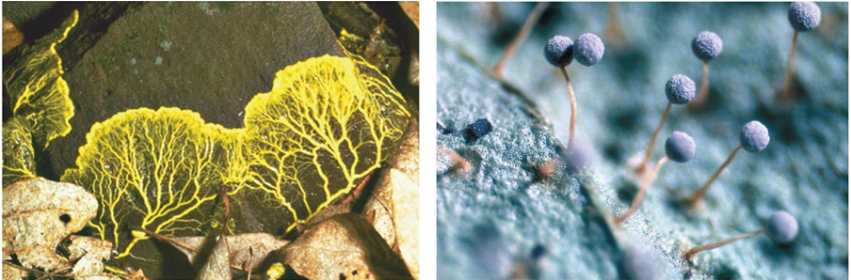
Amoebozoans: Slime Molds
Slime molds, or mycetozoans, were once thought to be fungi due to their
This resemblance between slime molds and fungi is a result of
Slime molds include two lineages
  Plasmodial slime molds:
  Cellular slime molds:
A
B

Slide 35
Amoebozoans: Tubulinids
Tubulinids are a diverse group of amoebozoans with
They are common unicellular protists in soil as well as
Most tubulinids are heterotrophic and actively seek and consume
Amoebozoans: Entamoebas
Entamoeba are parasites of
Entamoeba histolytica causes amebic dysentery, the third-leading cause of

Slide 36
Concept 28.6: Protists play key roles in ecological communities
Protists are found in diverse
Protists play two key roles in their habitats

Slide 37
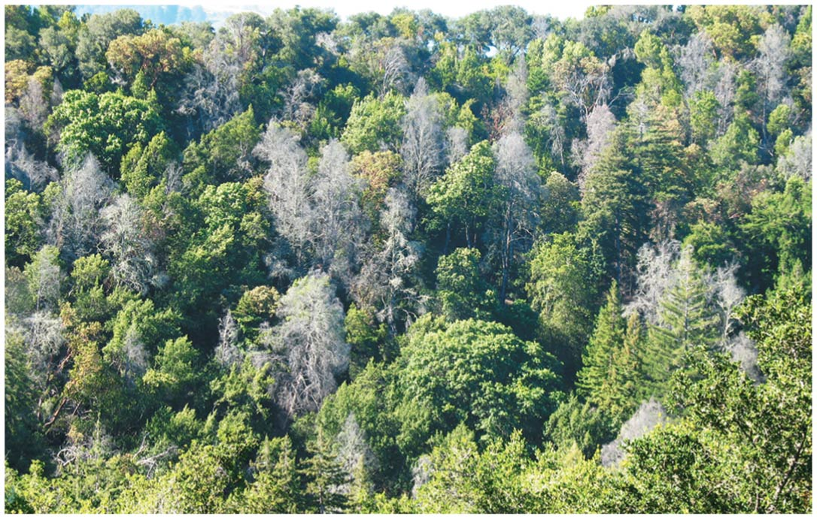
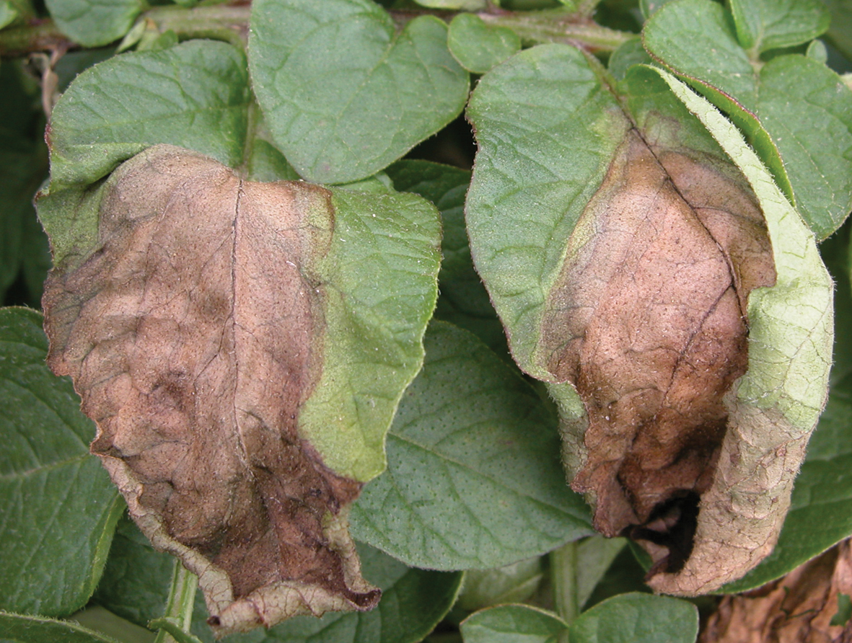
1. Symbiotic Protists
Some protist symbionts benefit their hosts
  Dinoflagellates
  Wood-digesting protists
Some protists are parasitic
  Plasmodium causes
  Phytophthora ramorum causes
  P. infestans causes
Notes:
Figure 28.27 A symbiotic protist

Slide 38
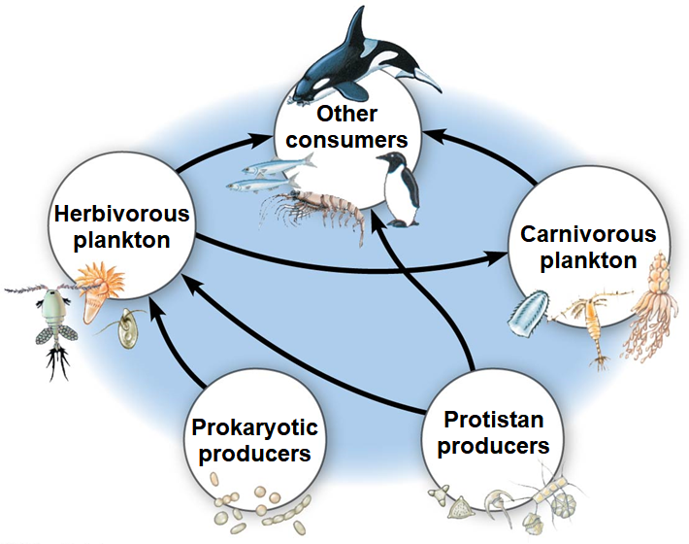
2. Photosynthetic Producer Protists
Many protists are important producers that obtain energy from the sun to
In aquatic communities, photosynthetic protists and prokaryotes are the
Photosynthetic protists are limited by nutrients; populations can

